Slide 1
IBM University Engagement Project Submission
“Exploring the Power of Agentic AI with IBM Granite and LangFlow”

Slide 2

Project Tile – [Network Intrusion Detection using Machine Learning]
Domain of Project – Cybersecurity / Networking
Student Name | Recent Passport Photo | Email ID | Mobile number [WhatsApp]
Sonika Sree T Y |  | 2803sonusree@gmail.com | 8667865356
[ Upload photo here ]

Slide 3
Problem Statement -
Problem Statement : Network Intrusion Detection
The Challenge
Cyberattacks are constantly evolving, and traditional rule-based systems struggle to keep up with new and disguised attack patterns. Network administrators need a fast, automated way to tell normal traffic from malicious traffic. Without real-time, automated detection, manual log monitoring is slow, error-prone, and cannot scale to modern network traffic volumes.
The Objective
Build a Machine Learning-based Network Intrusion Detection System (NIDS) that analyzes network traffic and classifies it as normal or an attack. The solution should:
Attack Classification – Detect and classify traffic into categories such as DoS, Probe, R2L, and U2R attacks, alongside normal traffic.
Feature-Based Analysis – Use 41 network traffic features (protocol type, service, flag, byte counts, error rates) to identify attack signatures.
High Accuracy Detection – Achieve high precision and recall to minimize false alarms and missed attacks.
Data-Driven Pipeline – Preprocess, encode, and scale network traffic data before feeding it into the classification model.
Model Evaluation –
accuracy, precision, and recall using a confusion matrix
F1-score for balanced performance measurement
Robustness (low false positive/negative rate)
Reliability (consistent results across test data)
Feature Importance Analysis – Identify which network attributes contribute most strongly to detecting an intrusion.

Slide 4
Proposed Solution -
Proposed Solution: ML-Based Network Intrusion Detection System
The proposed solution is a Random Forest classification pipeline built using Python, scikit-learn, Pandas, and NumPy to detect and classify network intrusions from the NSL-KDD dataset. The system addresses the challenge of identifying malicious traffic through a structured, data-driven machine learning workflow.
At its core, the solution processes raw network traffic records containing 41 features — including protocol type, service, flag, byte counts, and connection statistics — and transforms them into a machine-readable format using label encoding and feature scaling.
The pipeline consists of four key stages:
Data Preprocessing cleans the data and encodes categorical features (protocol_type, service, flag) using Label Encoding.
Feature Scaling standardizes numerical features using StandardScaler for consistent model input.
Model Training trains a Random Forest Classifier (100 estimators) on 80% of the data to learn attack vs. normal traffic patterns.
Model Evaluation tests the model on the remaining 20% of data, measuring accuracy, precision, recall, and F1-score.
The solution includes a confusion matrix and feature importance chart that visualize model performance and highlight which network attributes most strongly indicate an intrusion.
scikit-learn is used for model training and evaluation, while Pandas and NumPy handle data preprocessing. IBM Cloud Lite services support the overall project infrastructure as mandated.
Overall, this solution delivers an accurate and efficient intrusion detection model that distinguishes normal traffic from cyberattacks, enabling proactive network security monitoring.

Slide 5
Technology Used
Python & Kaggle Notebook - For data loading, analysis, model building, and experimentation
scikit-learn - For implementing the Random Forest Classifier and evaluation metrics (accuracy, precision, recall, F1-score)
Pandas & NumPy – For data loading, cleaning, and preprocessing of the network traffic dataset. Handles label encoding for a clean, consistent, and model-ready dataset.
IBM Cloud Lite – Mandated infrastructure supporting project deployment and scalability as required by the AICTE guidelines.
Matplotlib & Seaborn - For visualizing the confusion matrix and feature importance chart
NSL-KDD Dataset (Kaggle) – Labeled network traffic dataset used for training and testing the intrusion detection model

Slide 6
ML Pipeline Components Used -
1) Data Loading – Reads the NSL-KDD dataset (Train_data.csv) containing 25,192 network traffic records with 42 columns.
2) Label Encoding - Converts categorical features (protocol_type, service, flag) into numeric form for the model.
3) Feature Scaling - StandardScaler normalizes numerical features for consistent, balanced model input
4) Random Forest Classifier -Core ML model (100 estimators) that learns to distinguish normal vs. attack traffic.
5) Model Evaluation Module - Computes accuracy, precision, recall, F1-score, and a confusion matrix on the test set.
6) Feature Importance Analysis - identifies the top network attributes contributing to attack detection.

Slide 7
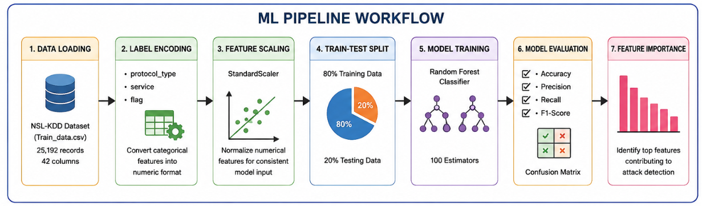
ML Pipeline Workflow -
[ Insert your ML pipeline / notebook workflow screenshot here ]

Slide 8
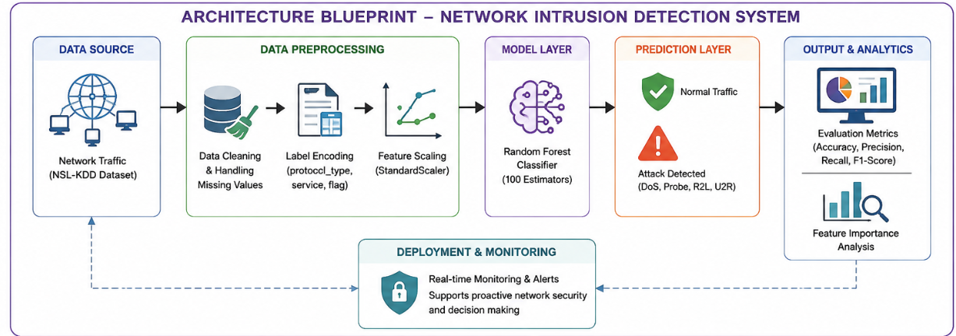
Architecture blueprint
[ Insert your architecture diagram here ]

Slide 9

Role of Machine Learning in the Solution
Role of Machine Learning in Network Intrusion Detection
Machine Learning enables the Network Intrusion Detection System to function as an intelligent, data-driven classifier rather than a static rule-based filter. Using a Random Forest Classifier trained on labeled network traffic data, the model learns the complex patterns that separate normal traffic from malicious activity.
The pipeline performs feature encoding, scaling, and classification in sequence, while working together as a single coherent workflow. This structured ML pipeline ensures efficient processing and accurate results.
Machine Learning also brings pattern recognition at scale, learning from thousands of traffic records to generalize to new, unseen connections. It supports rapid classification, enabling near real-time flagging of suspicious traffic.
Additionally, feature importance analysis reveals which network attributes most strongly signal an attack, adding interpretability to the model's decisions.
Overall, Machine Learning makes the system proactive, accurate, and scalable, acting like a vigilant digital security analyst that helps protect networks from intrusions.

Slide 10
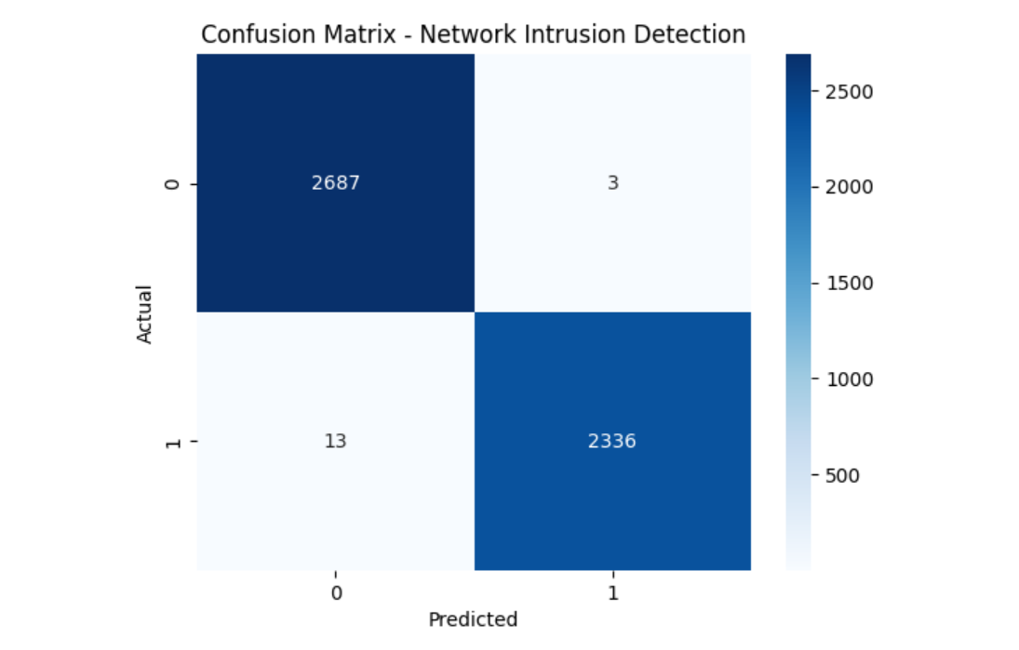
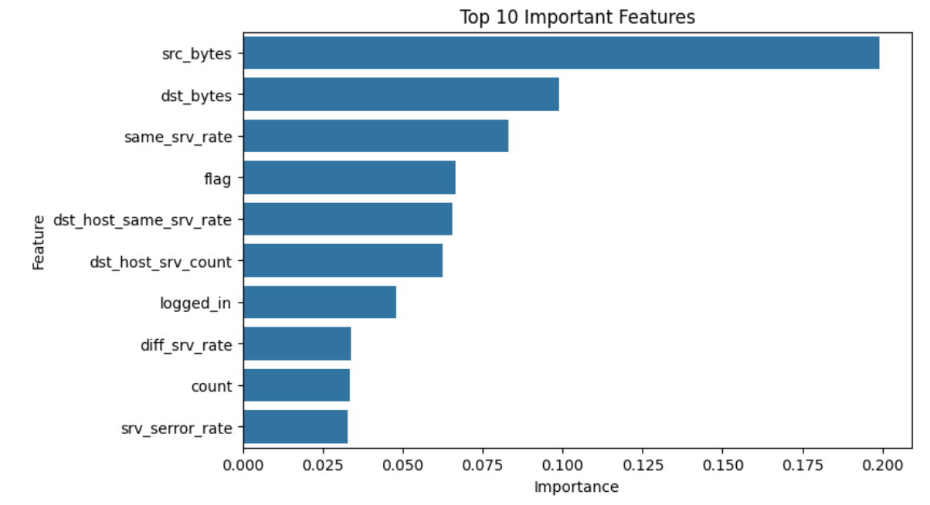
Model Performance Summary
99.68% accuracy achieved on the test set
Confusion Matrix
Feature Importance Chart
[ Insert your Confusion Matrix screenshot here ]
[ Insert your Feature Importance Chart screenshot here ]
·
·
·

Slide 11
Novelty and Uniqueness
The proposed Network Intrusion Detection system stands out by combining robust preprocessing, ensemble learning, and interpretability into a single efficient pipeline.
Ensemble Learning Power – Uses a Random Forest of 100 decision trees to capture complex, non-linear attack patterns more reliably than a single classifier.
High Precision & Recall – Achieves near-perfect classification (99.68% accuracy) while minimizing both false alarms and missed attacks.
Interpretable Results – Feature importance analysis shows exactly which network attributes drive each prediction, unlike black-box models.
Lightweight & Fast – Trains and predicts quickly on tabular data, making it practical for near real-time deployment.
Well-Tested Dataset – Built on the widely-used NSL-KDD benchmark, allowing fair comparison with existing research.
Preventive Security Focus – Goes beyond detection to highlight which traffic features administrators should monitor most closely.
Scalable & Cloud-Ready – Deployable on IBM Cloud Lite services for wider accessibility, ensuring reliability at scale.
This makes the solution a reliable, transparent, and efficient intrusion detection model, not just a black-box classifier.

Slide 12
Git Hub Link
· Please create public github repository (Enable Add README button while creating repository) with format –
Please test and Paste the working Github URL – https://github.com/sonikasree2803-ui/Network-intrusion-Detection-.git
·
·
·

Slide 13
Future Scope
1. Real-Time Deployment & Live Traffic Monitoring –
The model can be deployed as a live network monitoring service that scans traffic in real time and sends instant alerts to administrators. This would extend the current offline classification into a proactive, continuously running intrusion detection system for production networks.
2. Deep Learning & Zero-Day Attack Detection –
Extending the system with deep learning models (e.g., LSTM or autoencoders) could help detect previously unseen, zero-day attack patterns that a Random Forest model may miss, further strengthening network security coverage.
·
·
·

Slide 14
Certificates Earned:
Please add your credly certificate
[ Upload your Credly certificate here ]

Slide 15
Certificates Earned:​
Add your IBM BOB Certificate
[ Upload your IBM BOB certificate here ]

Slide 16


